Slide 1


Slide 2
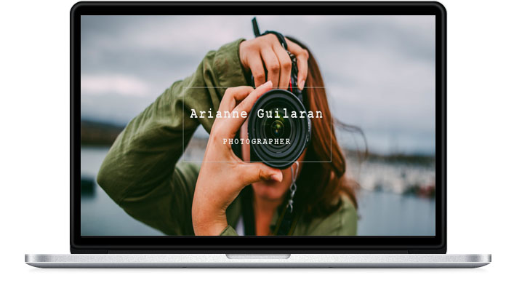

Slide 3
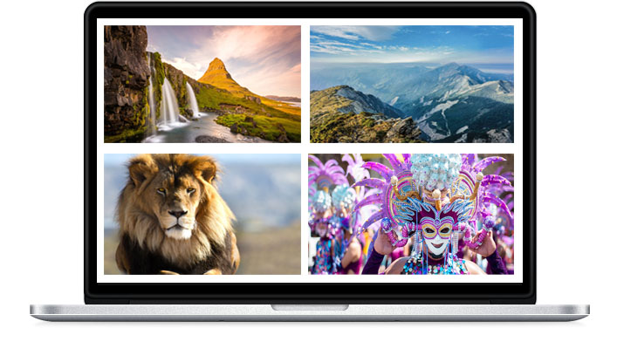

Slide 4
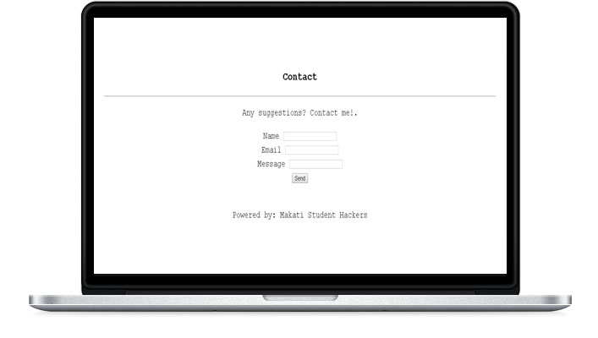
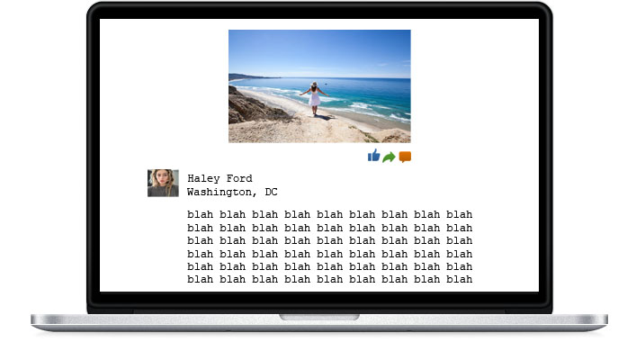

Slide 6
PHOTOFOLIO’S FEATURES

Slide 7
SIMPLE USER INTERFACE & ACCESSIBLE TO ALL USERS
A user-friendly website that has simple user interface and easy accessible for all the users in any age.

Slide 8
EFFECTIVE NAVIGATION
It has a good search feature, multiple ways to explore, easy uploading of photos, fast button action

Slide 9
MOBILE COMPATABILITY
People can use their phones to access this website with no hassle and fast loading

Slide 10
PHOTOFOLIO’S ADVANTAGES

Slide 11
ONLINE TRAVEL JOURNAL
This website will serves as an online travel blog for the people who likes adventure

Slide 12
LEARN NEW SKILLS
This website will help other adventurers to know the other skills they could learn in a particular country most especially its culture and tradition

Slide 13
PEOPLE ARE CONNECTED AROUND THE WORLD
Even the people who don’t have much time travelling can see the beautiful places other travellers

